Slide 1

DAY 3
Object Recognition
Using
openCV YOLO Algorithm

Slide 2
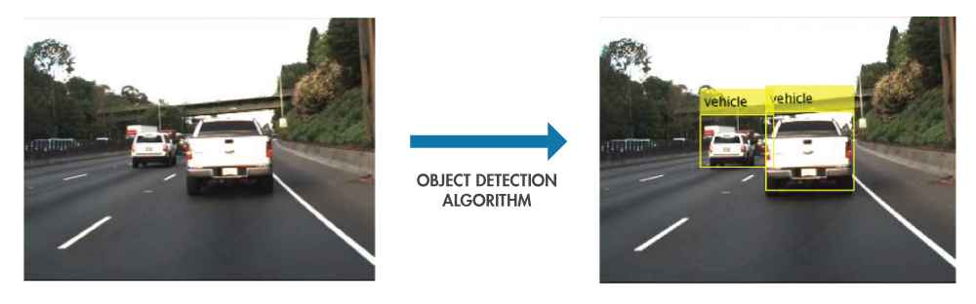
Introduction
Humans can detect and identify objects present in an image. The human visual system is fast and accurate and can also perform complex tasks like identifying multiple objects and detect obstacles with little conscious thought. The availability of large sets of data, faster GPUs, and better algorithms, we can now easily train computers to detect and classify multiple objects within an image with high accuracy.

Slide 3
List Of Algorithms
YOLO
YOLO is a clever convolutional neural network (CNN) for doing object detection in real-time. The algorithm applies a single neural network to the full image, and then divides the image into regions and predicts bounding boxes and probabilities for each region.
YOLO is popular because it achieves high accuracy while also being able to run in real-time.With YOLO, a single CNN simultaneously predicts multiple bounding boxes and class probabilities for those boxes. YOLO trains on full images and directly optimizes detection performance

Slide 4
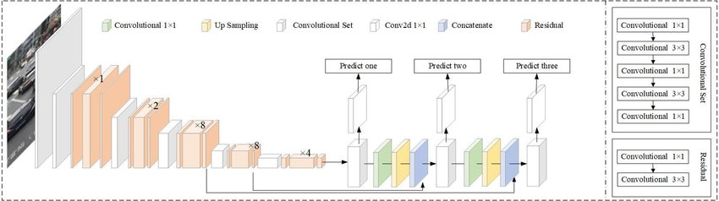
YOLOv3 Architecture
No. of layers = 254

Slide 5
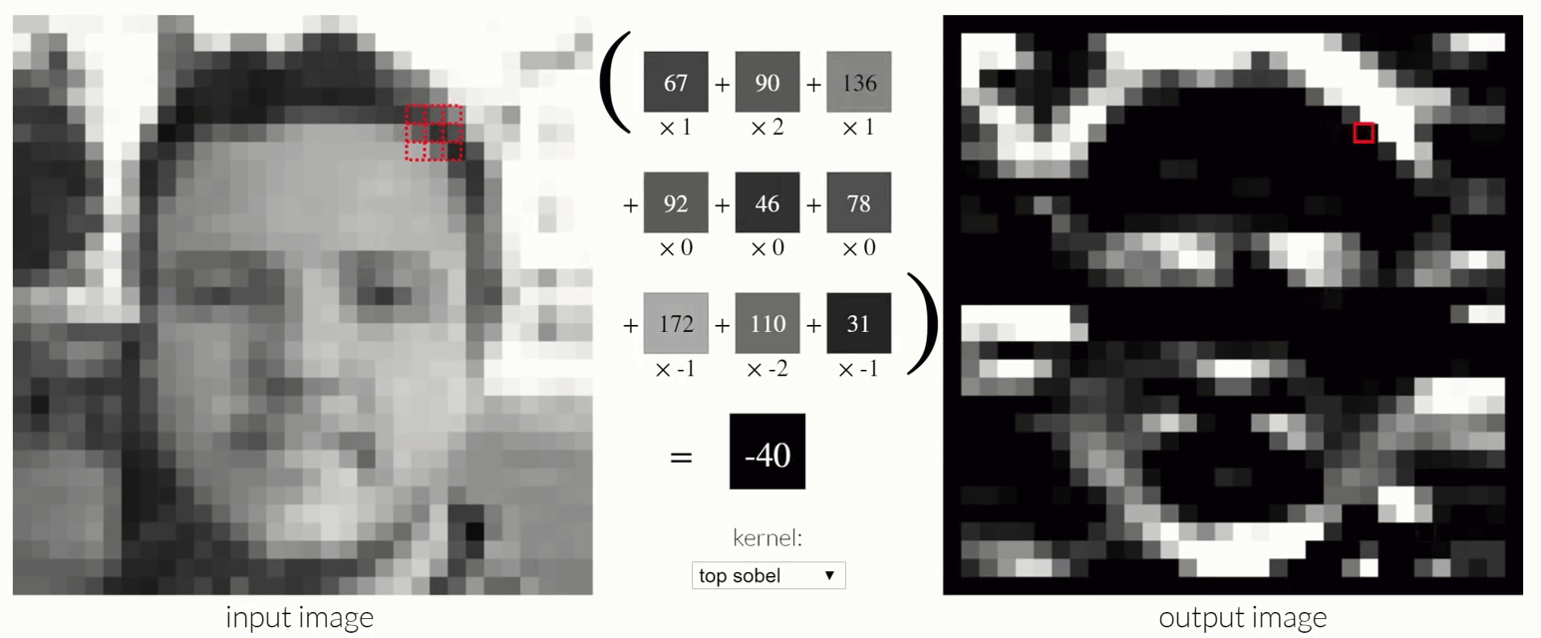
Convolution Process
Formula:
(n,n,c) * (f,f,cf) gives (n-f+1, n-f+1,cf)

Slide 6
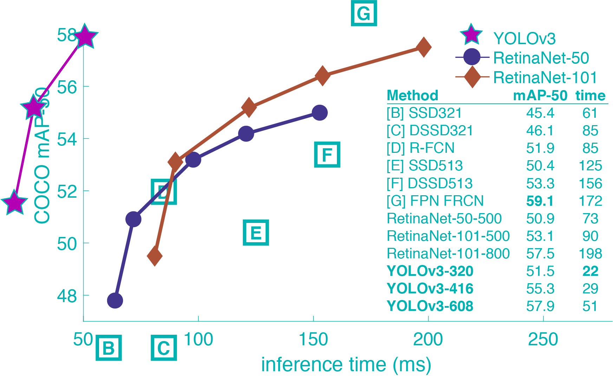
Comparison of YOLO to other Algorithms
YOLOv3 is extremely fast and accurate. YOLO learns generalizable representations of objects so that when trained on natural images and tested on artwork, the algorithm outperforms other top detection methods.

Slide 7
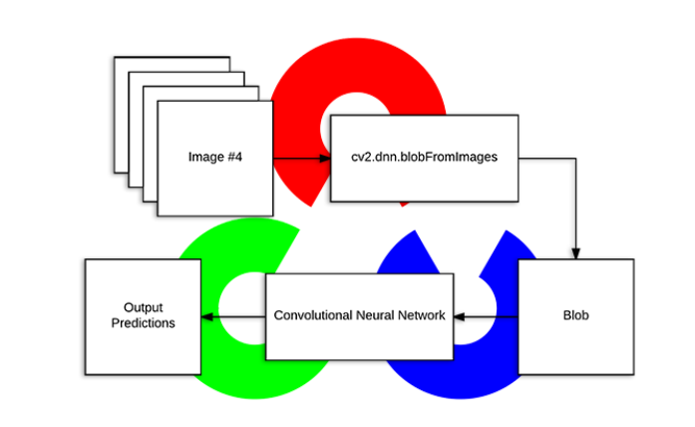
Flowchart

Slide 8
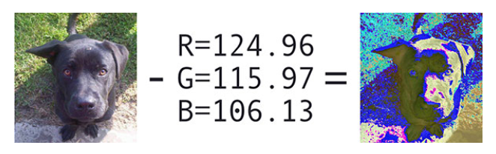
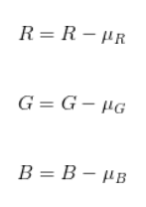
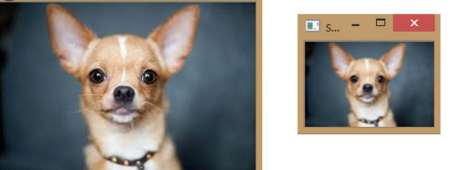
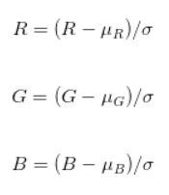
Mean Subtraction
Scaling

Slide 9
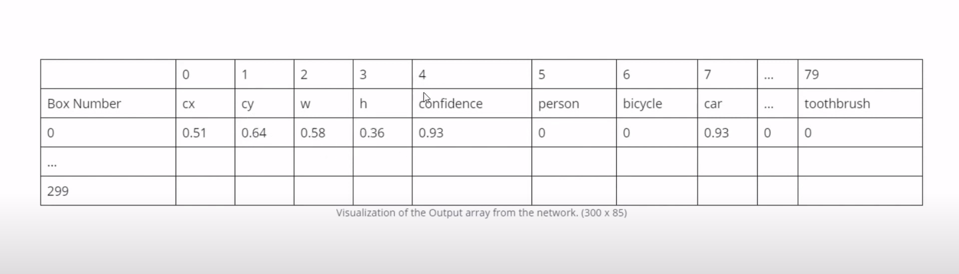
Output from forward pass

Slide 10
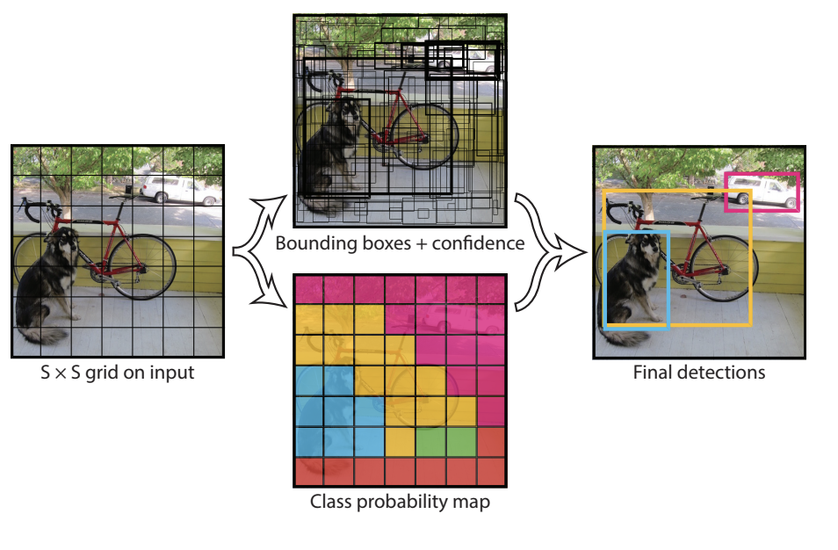
For each of the bounding box, the network outputs a class probability and offset values for the bounding box. The bounding boxes having the class probability above a threshold value is selected and used to locate the object within the image.

Slide 11
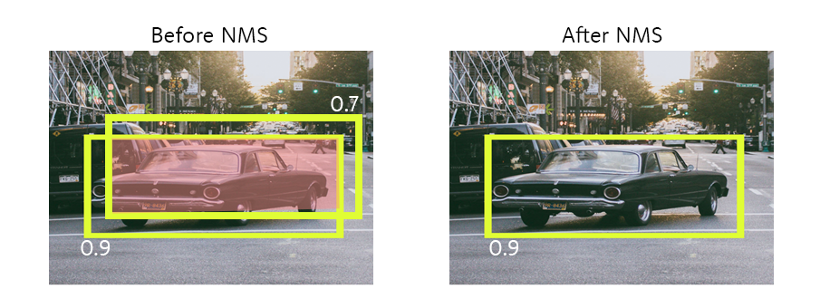
Non Max Suppresion
Algorithm may find multiple detections of the same objects. Rather than detecting an object just once, it might detect it multiple times. Non-max suppression is a way for you to make sure that your algorithm detects each object only once. IOU(Intersection Over Union) = Intersection / Union
If IOU is greater than specified threshold then it discards the bounding box with lesser confidence

Slide 12
Thank You
Feel free to ask questions if any!

